Slide 1
JAMES & ELIZABETH BRAMSEN TROPICAL FORESTS
Brookfield Zoo Chicago
Working Title: Great Apes Outdoors

Slide 2
MAC Consulting @ Brookfield Zoo Chicago
2017 conversation started with a simple phone call for help
2018 started master planning services
2019 finished land and building surveys for 235-acre campus with 170 structures
2020 organized trustee task forces around master planning (thru Covid)
2021 held numerous symposia for trustees, building excitement
  New CEO is named and asks a challenging question….

Slide 3
How fast to get the great apes outdoors?
60 Month Scenario
Scope | Project Timeline | Task Timeline
Define scope, budget, and schedule | 0 – 3 Months | 3 Months
Start design at risk | 2 – 6 Months | 5 Months
Regulatory work, zoning, and utilities | 4 – 18 Months | 15 Months
Finalize scope, budget, and schedule | Month 18
Start design in earnest | Month 18 – 27 | 9 Months
Obtain permits | Month 28 – 31 | 4 Months
Commence construction | Month 32 – 60 | ~24 Months

Slide 4
How fast to get the great apes outdoors?
51 Month Scenario
Scope | Project Timeline | Task Timeline
Define scope, budget, and schedule | 0 – 3 Months | 3 Months
Start design at risk | 2 – 6 Months | 5 Months
Regulatory work, zoning, and utilities | 4 – 9 Months | 9 Months
Finalize scope, budget, and schedule | Month 18 | 1 Month
Start design in earnest | Month 16 – 22 | 7 Months
Obtain permits | Month 23 – 26 | 4 Months
Commence construction | Month 27 – 48 | ~22 Months

Slide 5
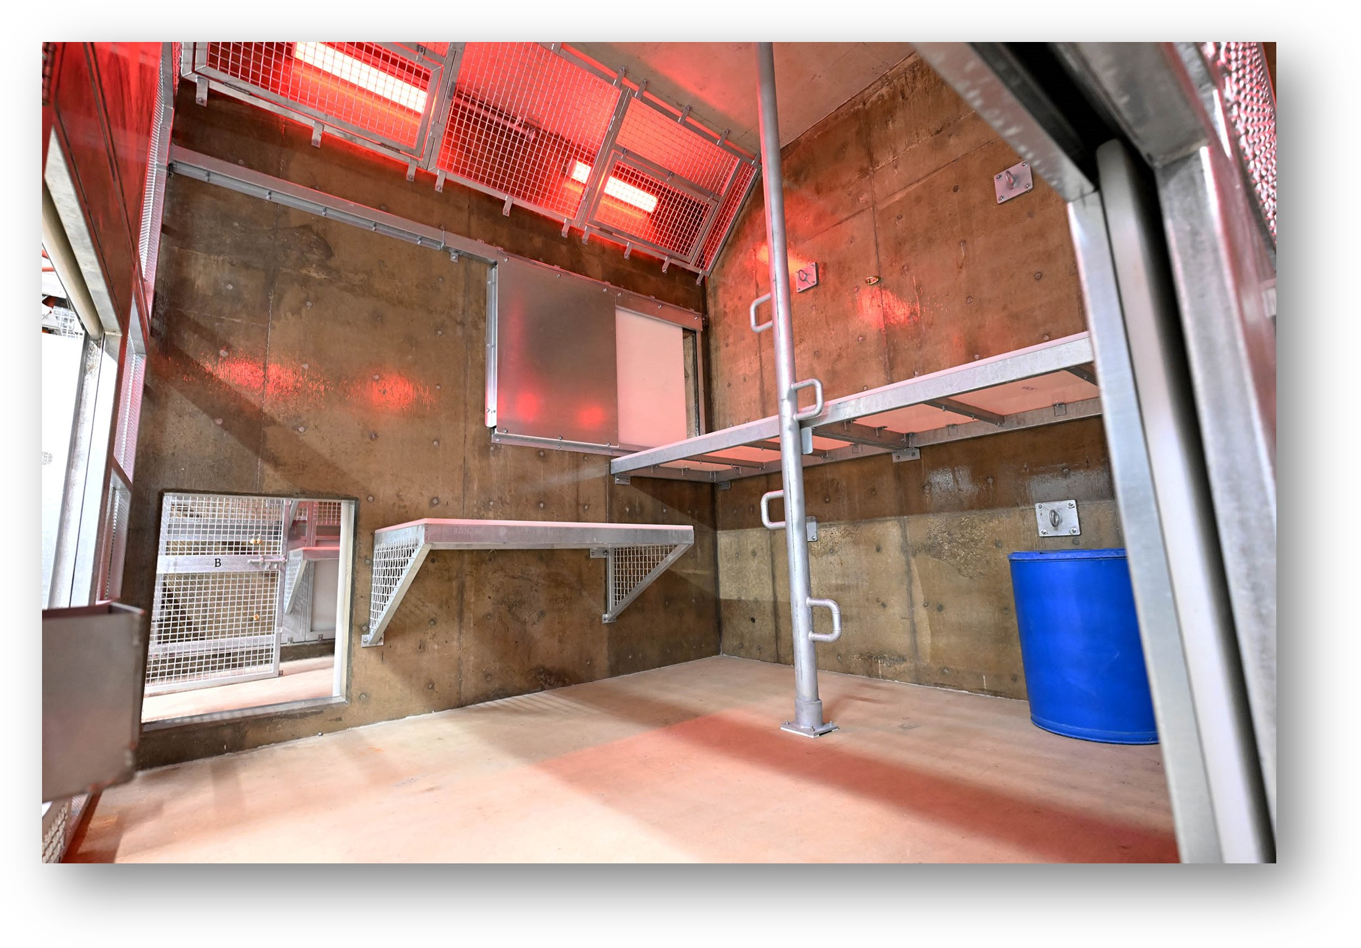
Getting the great apes outdoors: 43 Months
Real time: November 2021 – June 2025
How?
  Trusted partner
  Negotiated all work with an experienced team
  Utilized Best Practices
    Design build engineering
    Transparency with all regulatory agencies
    Intensively studied other zoos for “lessons learned”
  Said NO a lot

Slide 6
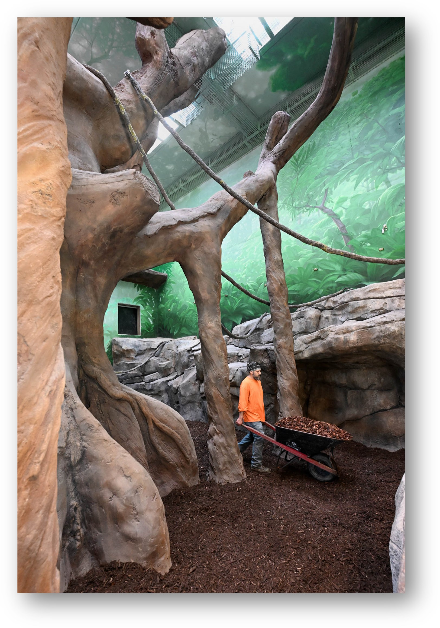
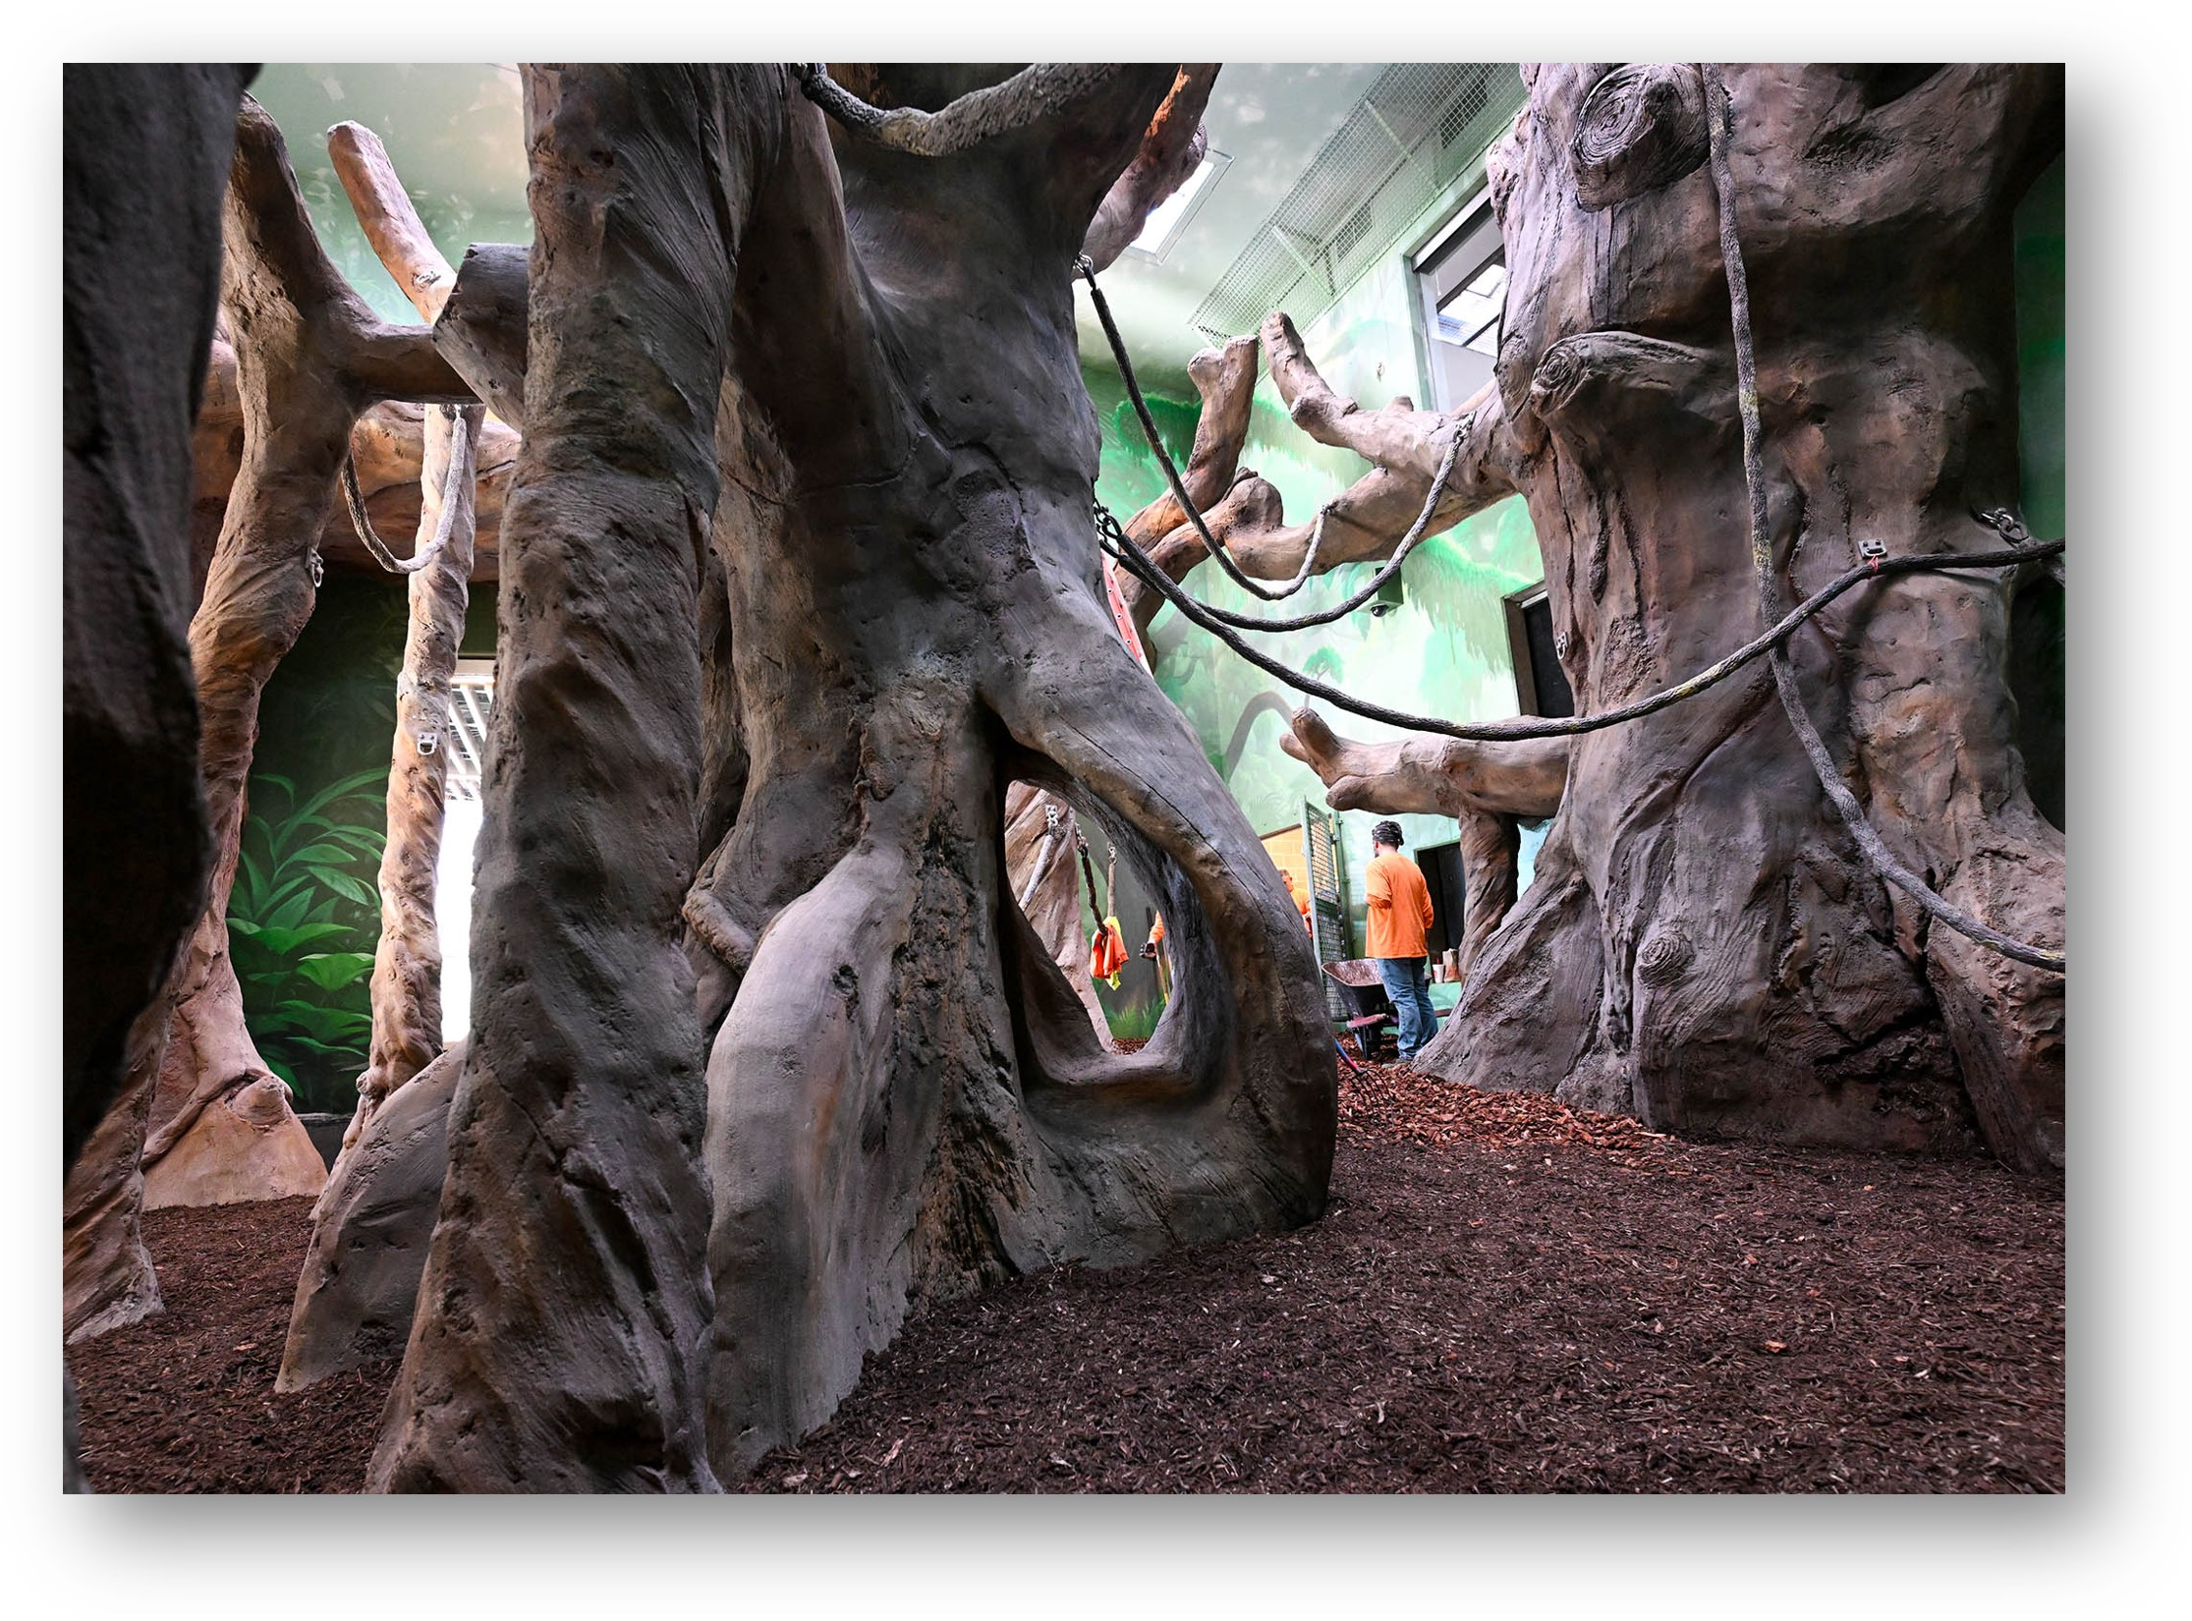
Interior Buildout

Slide 7
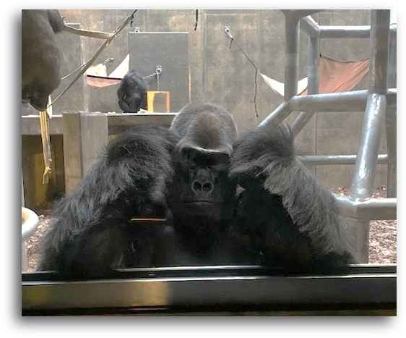
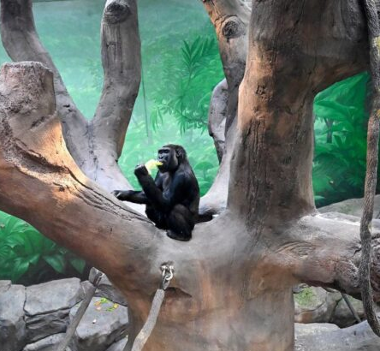
Interior Buildout

Slide 8
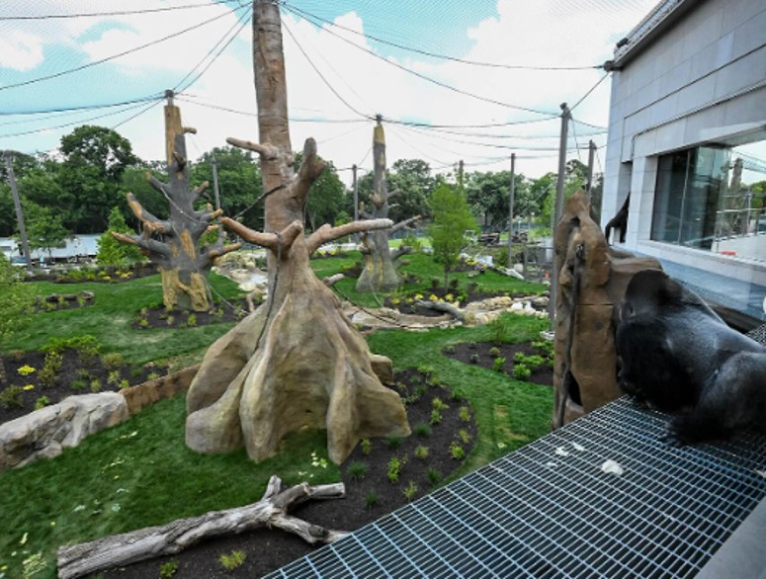
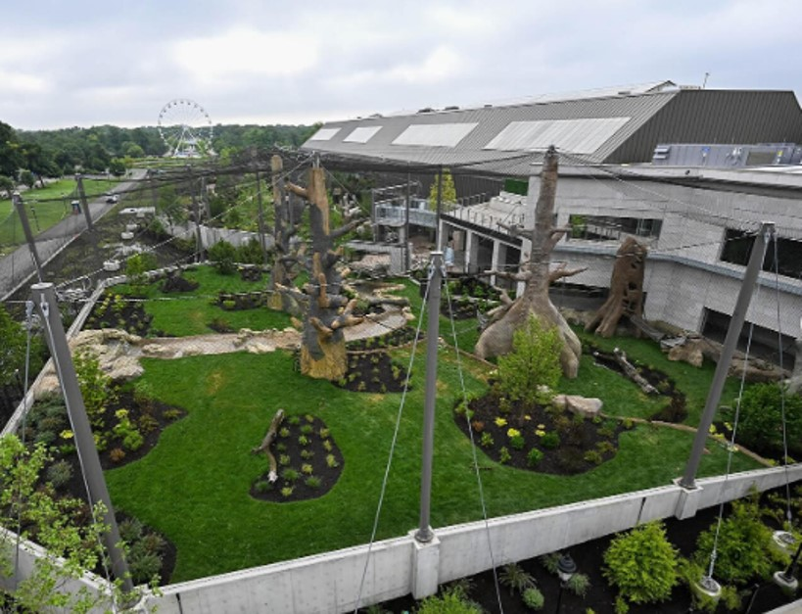
Delivering an Outdoor Experience

